Slide 1
Sentiment Analysis Twitter
Studi Kasus : #YoutubeDOWN
Aminurachma A - 17.52.0001

Slide 2
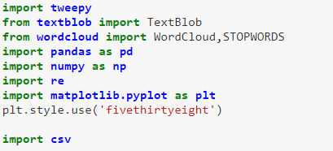
IMPORT LIBRARY

Slide 3
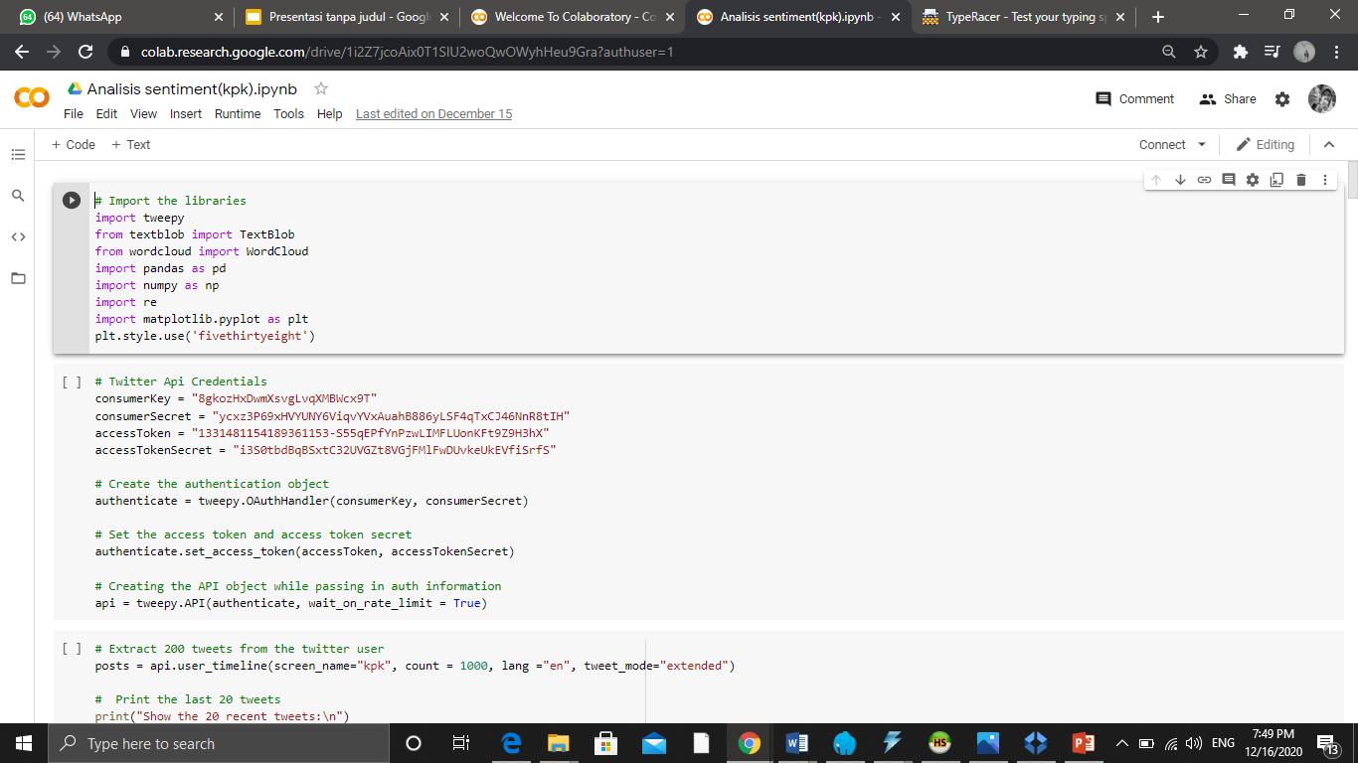
IMPORT TWITTER API CREDENTIALS

Slide 4
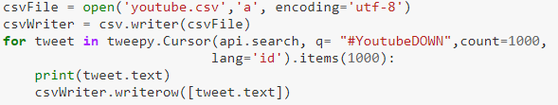
SCRAPING 1000 DATA &
SAVE TO CSV FILE

Slide 5

READ CSV FILE WITH LIBRARY PANDAS

Slide 6
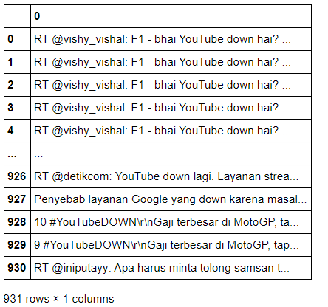
OUTPUT

Slide 7
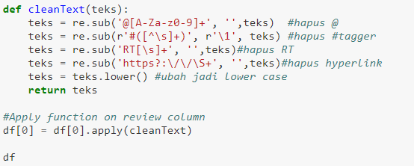
CLEANING TEXT

Slide 8
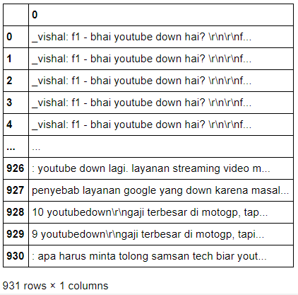
OUTPUT

Slide 9
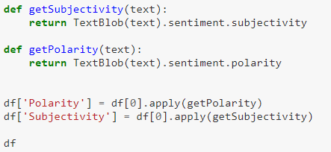
CALCULATE POLARITY AND SUBJECTIVITY FROM THE TEXT

Slide 10
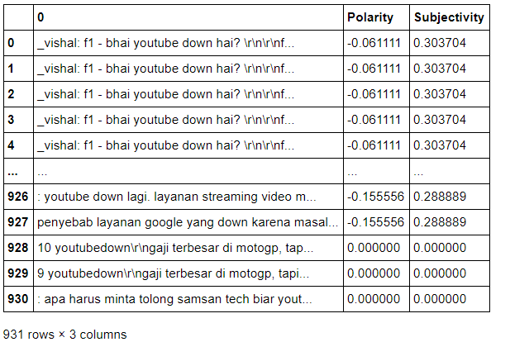
OUTPUT

Slide 11

DATA VISUALIZATION WITH WORD CLOUD

Slide 12
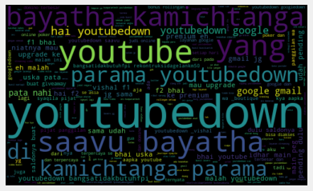
OUTPUT

Slide 13
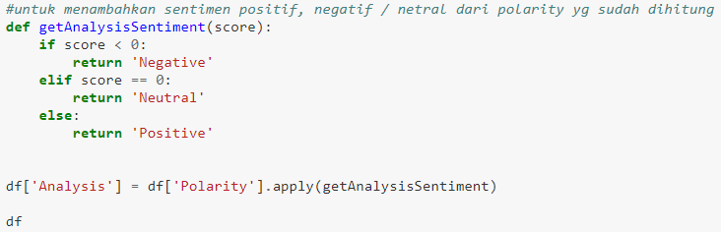
ADD POSITIVE, NEGATIVE , AND NEUTRAL SENTIMENT FROM THE CALCULATED POLARITY

Slide 14
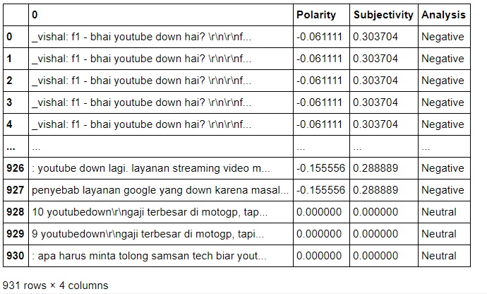
OUTPUT

Slide 15
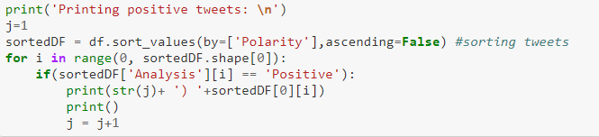
SHOWING POSITIVE TWEETS

Slide 16
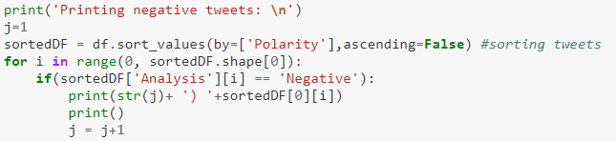
SHOWING NEGATIVE TWEETS

Slide 17
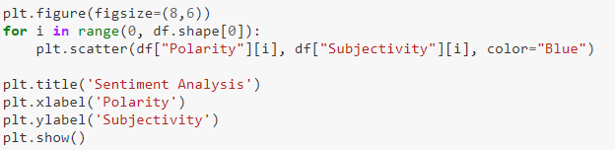
CREATE SCATTER PLOT

Slide 18
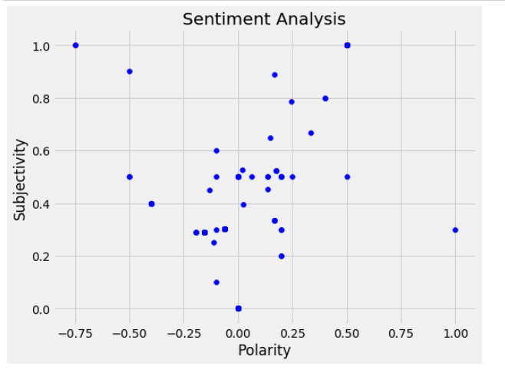
OUTPUT

Slide 19

DISPLAYS POSITIVE, NEGATIVE AND NEUTRAL IN THE FORM OF A BAR CHART

Slide 20
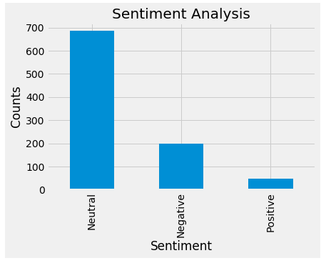
OUTPUT

Slide 21
TABLE OF CONTENTS
Business Overview
Management Plan
01
04
Market Analysis and Competition
Operating Plan
02
05
Sales Marketing Plan
Financial Plan
03
06
Here you could describe the topic of the section
Here you could describe the topic of the section
Here you could describe the topic of the section
Here you could describe the topic of the section
Here you could describe the topic of the section
Here you could describe the topic of the section

Slide 22
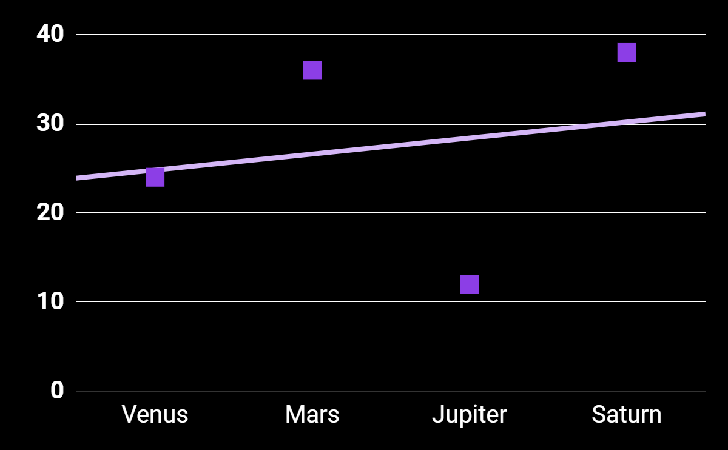
MARKET TRENDS
Trend
Input

Slide 23
THANK YOU

